Slide 1
INFORMATION ENCODING STANDARDS-02
BDAT-1001
01 BDAT1001-22S-30631
FINAL PROJECT PART-2
Security Authorization
Submitted By:
Ramprakash Lakshminathan
Sai Pranank Batthini
Sesha Sai Gopal
Group: 5
Time-Table: A

Slide 2
PROJECT SUMMARY
The project summary comprises the essential criteria for developing an API and details on how the system is maintained while maintaining the highest level of security.
Data must be authenticated and checked for authorization so that it cannot be accessed by anybody who does not have access to it.
Maintaining information standards is crucial since data security is the primary issue when sharing and accessing data across various systems, resources, businesses, and customers.
The application is controlled based on the Role. Admin, Manager & Test User, each having unique privileges.

Slide 3
ABOUT OUR TEAM
We are a team of 3, Ramprakash, Sai Pranank & Sesha Sai. We are pursuing Big Data Analytics at Georgian College.
Prior Experience:
Ramprakash : Operations Manager at Textile Manufacturing Firm
Sai Pranank: Research and Development in Biomedicals
Sesha Sai: Bigdata Engineer
We will be applying our skills in developing a web application for maintaining the user contact information in a secured way using entity framework.

Slide 4

Part 1 : Demonstration
There are 3 major sections in the application,
Manager: Has access to approve or reject the new and existing user profile after submitting upon reviewing.
Admin: Has access to view the user info and can Edit and Delete the profiles.
User: Will be allowed to create and delete the profile, and submit for the Manager’s approval.

Slide 5
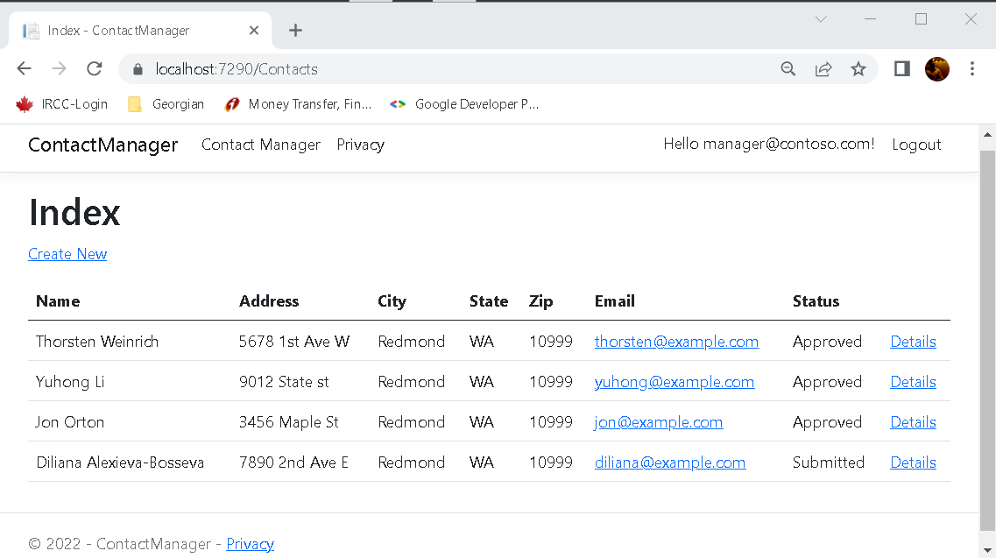
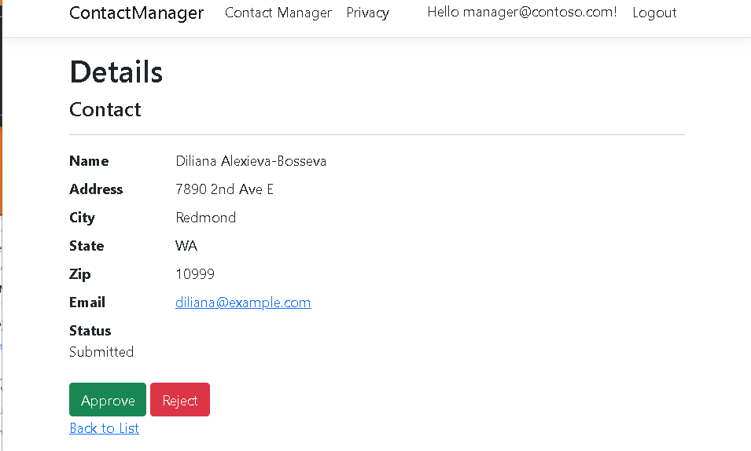
Manager
Manager’s dashboard has the list of user, allowing him to view the user profile.
After reviewing, the profile will be Accepted or Rejected.
manager@contoso.com

Slide 6
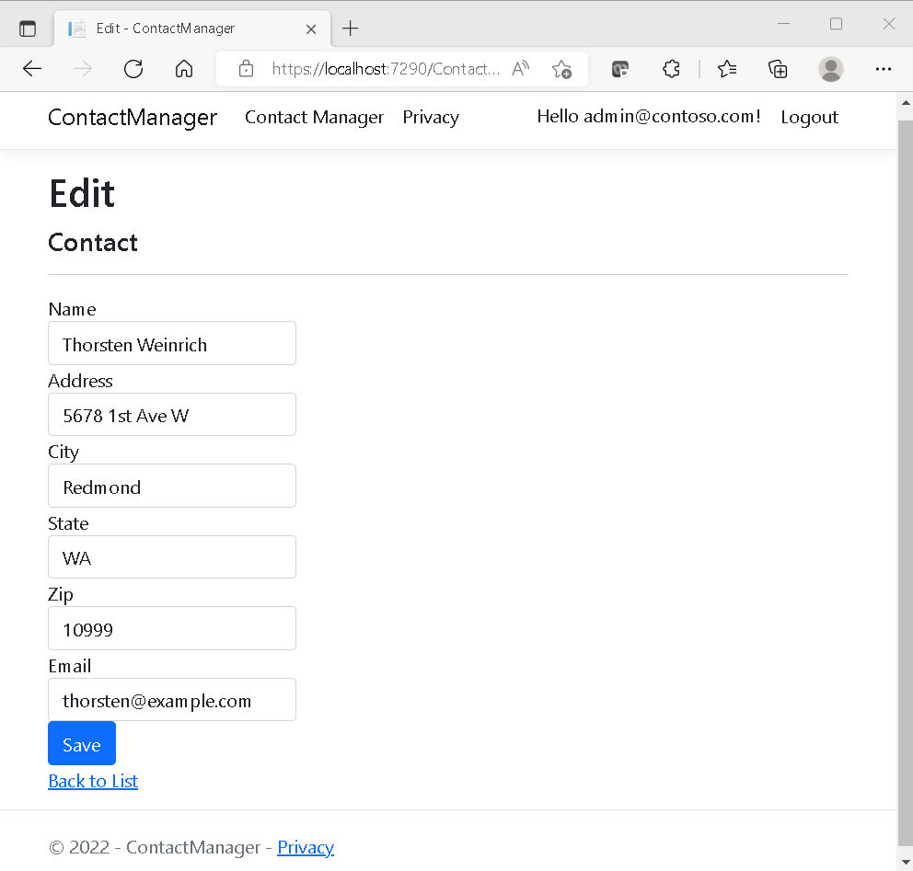
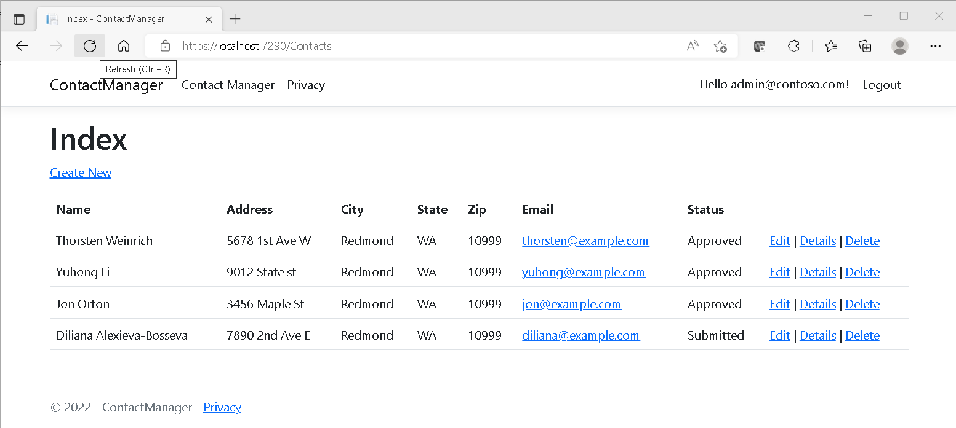
Admin
Admin can view, edit and delete the profiles.
admin@contoso.com

Slide 7
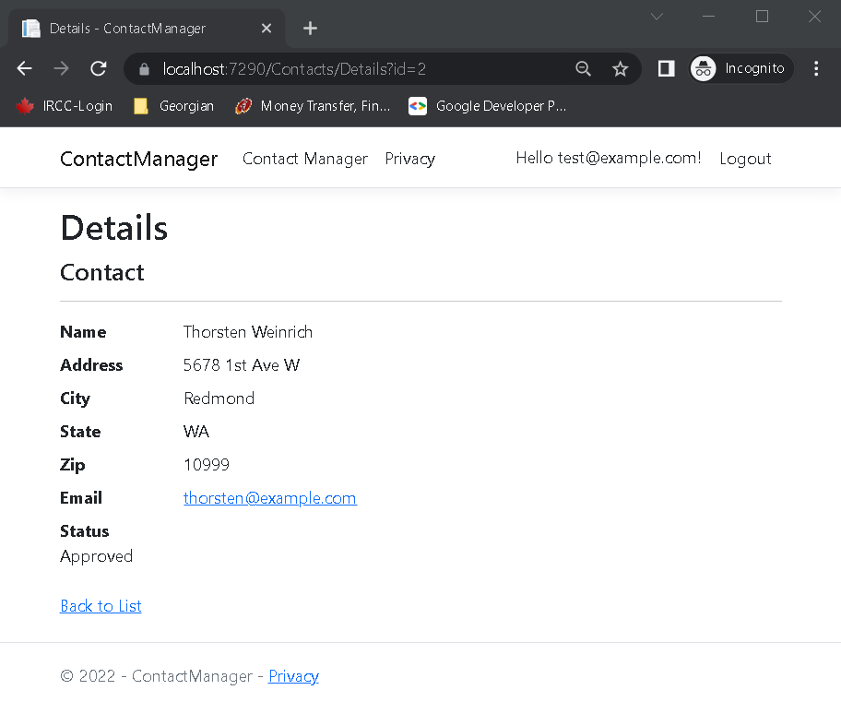
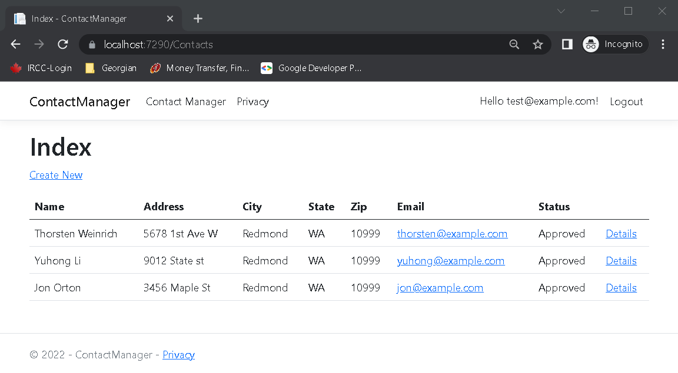
User
Users are allowed to create there profiles and submit.
test@example.com

Slide 8
Git-Repo
Please refer the below link to access the code for ContactManager.
https://github.com/SeshaSaiG/Information-Encoding-Standard/tree/main/ContactManager

Slide 9
How can we transfer personal data securely within their network?
Best way to transmit data is by encrypting it and is also highly recommended.
If data needs to be sent securely within a network, the Secure Socket Shell (SSH) protocols can be utilised. The SSH suite of protocols, which includes a complex password and public key authentication, is the best choice for secure data transport.
SSH may be used to securely transport sensitive data across a network because it also offers data encryption.
Data is transferred securely between parties using JSON Web Tokens (JWT), a JSON encoded form. The focus of JWT is on signed tokens. The data is protected from third parties and its integrity is ensured by the encrypted token.

Slide 10
2. What security protocol is best for transferring personal files?
SFTP is the most popular of all the various protocols for transferring personal data, despite the fact that there are many others.
The most secure authentication method, which includes complex passwords and SSH keys, is used by SFTP.
An application-level protocol called HTTP enables communication across various systems.

Slide 11
3. Can we encode and encrypt images?
Yes, using various encryption algorithms, photos may be encoded and encrypted.
We can utilize third-party encryption technologies that randomly rearrange image pixels in accordance with computational logic, and then at the receiver's end, decode the image using the same logic.
Alternately, we might design our own tool using encryption and decryption algorithms.

Slide 12
4. Our database cannot be moved from the site and we need to be able to access it externally using a secure API. Can you explain the architecture of a secure API?
If we need to use an external API to access the database, we must ensure that our data is being accessed correctly and is secure against unauthorised access.
Our backend and frontend work can be securely relocated using a cloud service thanks to the architecture used for a secure API.

Slide 13
5. Can you recommend a secure framework for coding an API?
Authorization must be taken into account in a secure framework, and the PUT and POST procedures used to enter data into a system or database must be secure so as not to compromise the integrity of the data.
To be used in the coding of an app, authentication and authorization must be implemented on a framework.

Slide 14
6. What data interchange format should we use while transferring data between locations?
Data can be sent between sites using the Java Script Object Notation (JSON) data interchange format.
Despite being a Java script extension, it is independent of the programming language. Writing and parsing it are simple.
Because xml files are significantly challenging to write and parse, it was created to replace xml.

Slide 15
7. How should we store our data in our many locations?
We can utilise RDBMS to access the data anytime we need it, and we can replicate the data across numerous servers in various places.
Data can be stored in numerous places using Oracle database features like striping and mirroring, for instance. Both easier access and more data security are provided by this.

Slide 16
8. What are the ethical concerns related to the transmission of personal data?
Personal information must not be disclosed to outside sources without access.
Privacy must be a fundamental consideration, and privacy violations must not be tolerated.
A security flaw or hack should not cause data to leak.
Without both parties' consent, data cannot be shared with anyone else.

Slide 17
REFERENCES LINK
https://docs.microsoft.com/en-us/aspnet/core/security/authorization/secure-data?view=aspnetcore-6.0

Slide 18
THANK YOU

